Slide 1
Java – An introduction

Slide 2
Contents
What is Java and Why?
Java distributions
Components and Tools
Installation – Windows
Creating, running and understanding a sample java program
Packaging and Deploying
OOPS Concepts
Annotations

Slide 3
1. What is Java and Why?
A general-purpose & Object-oriented programming language
Created by Sun Microsystems, released in 1995, acquired by Oracle
Enabled the internet of things
a language that could run on consumer appliances (mobiles, TV, refrigerators..)
Became popular because of applets
small programs which could run inside of a web browse
"Write once, run anywhere"

Slide 4
Continued…
Similarities with C++ & C# and NOT related JavaScript
Scala and Groovy run on JVMs
Influenced C# but benefited both ways.
Great for
Building large enterprise applications
can be used for small tasks but (my opinion) it’s less suited as it is too heavyweight. – ex dev-ops and scripts
Building huge online systems
Writing programs for your Android phones specifically.
Writing code for small embedded devices
Alternates
C#/.NET stack from Microsoft

Slide 5
2. Java distributions
Java SE (Standard edition)
A minimum requirement for java applications
Provides JVM, JCL, JRE, JDK
Java EE (Enterprise edition)
Supports applications running on web/application servers and big data technologies
Features - JPA, JSF, JSP, JAX-RS, EJB, CDI
Java ME (Micro edition)
Supports applications running on mobile and embedded devices
Getting popular due to Internet of Things devices

Slide 6
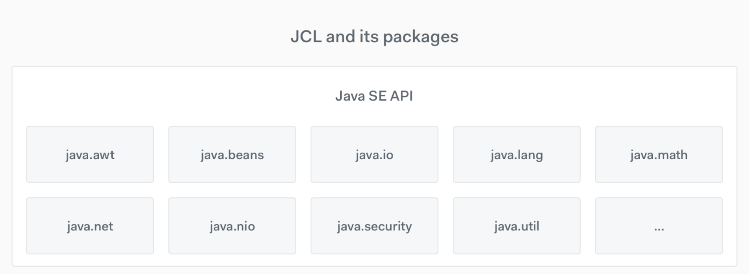
3. Components and Tools
JVM (Java virtual machine)
Execution environment for Java-based application
Running a java program starts JVM (%java )
Manages system memory
Vendor implementations of JVM specifications - OpenJDK, IBM, Oracle..
JRE (Java Runtime Environment)
contains class libraries(rt.jar), JVM (java exe), and other supporting files
JDK (Java Development Kit)
contains tools required to write Java programs, and JRE to execute them.
includes a compiler, Java application launcher
JCL (Java Class Libraries)
Standard java libraries
Over 8000 classes

Slide 7
Continued…
Java compiler
translates Java source code into the JVM bytecodes
translates the entire program at once
all the errors shown once at the end of the compilation
Java interpreter
implements the JVM specification
executes the bytecodes (and thereby running your program)
Any editor
Compile
Interpret & Run
.java
%javac <java file>
.class
Machine code
%java <main class name>
Source code
Byte code
Results

Slide 8
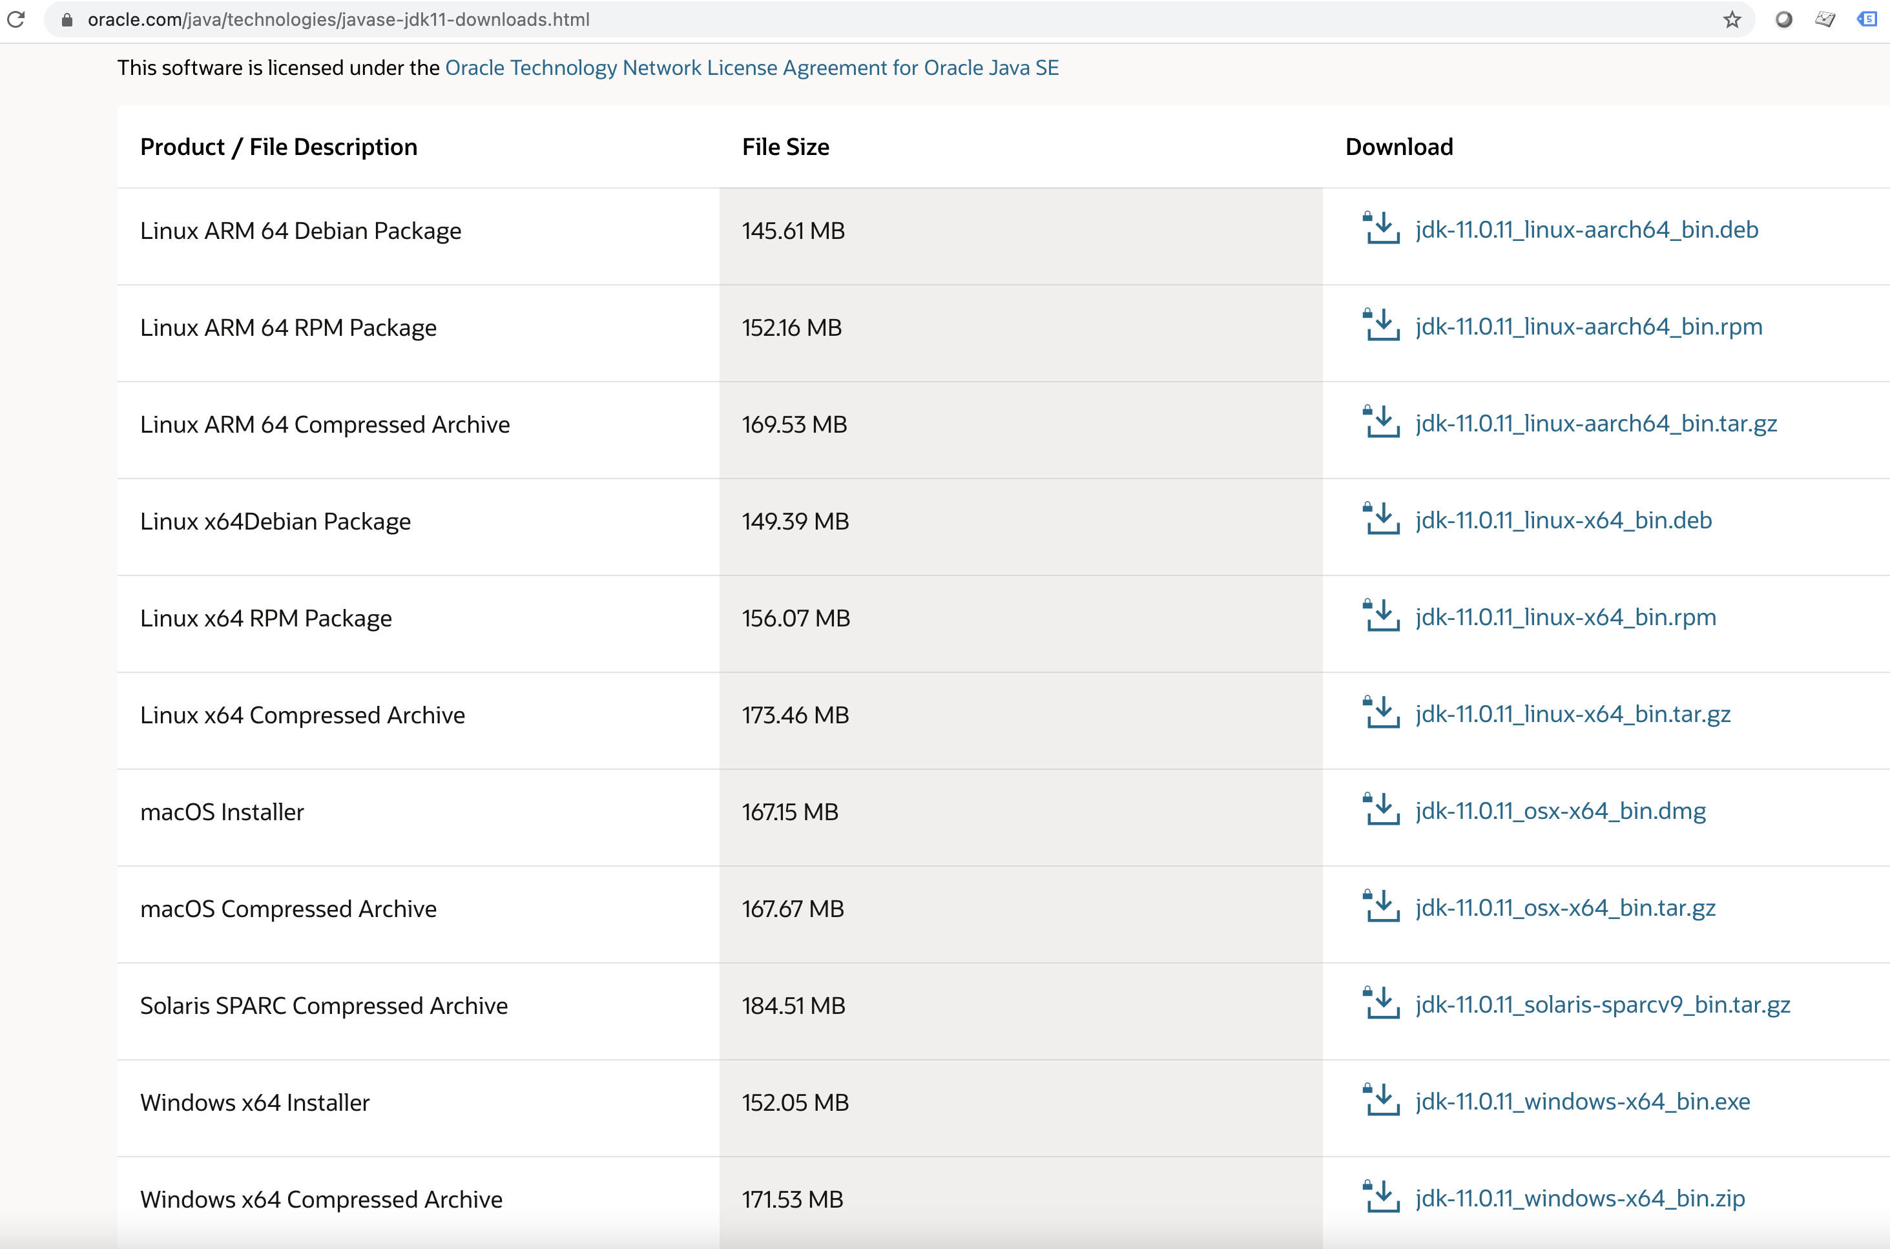
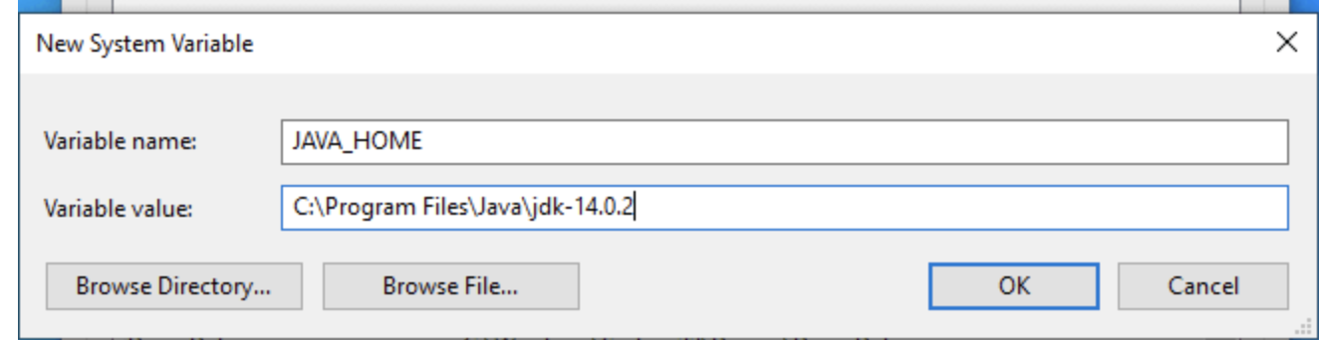
4. Installation - Windows
Visit - https://www.oracle.com/java/technologies/javase-downloads.html
Choose right java version and installer
Download and run exe – follow instructions
Set JAVA_HOME and update PATH variable to include (%JAVA_HOME%\bin)
Open CMD and run `%javac –version`

Slide 9
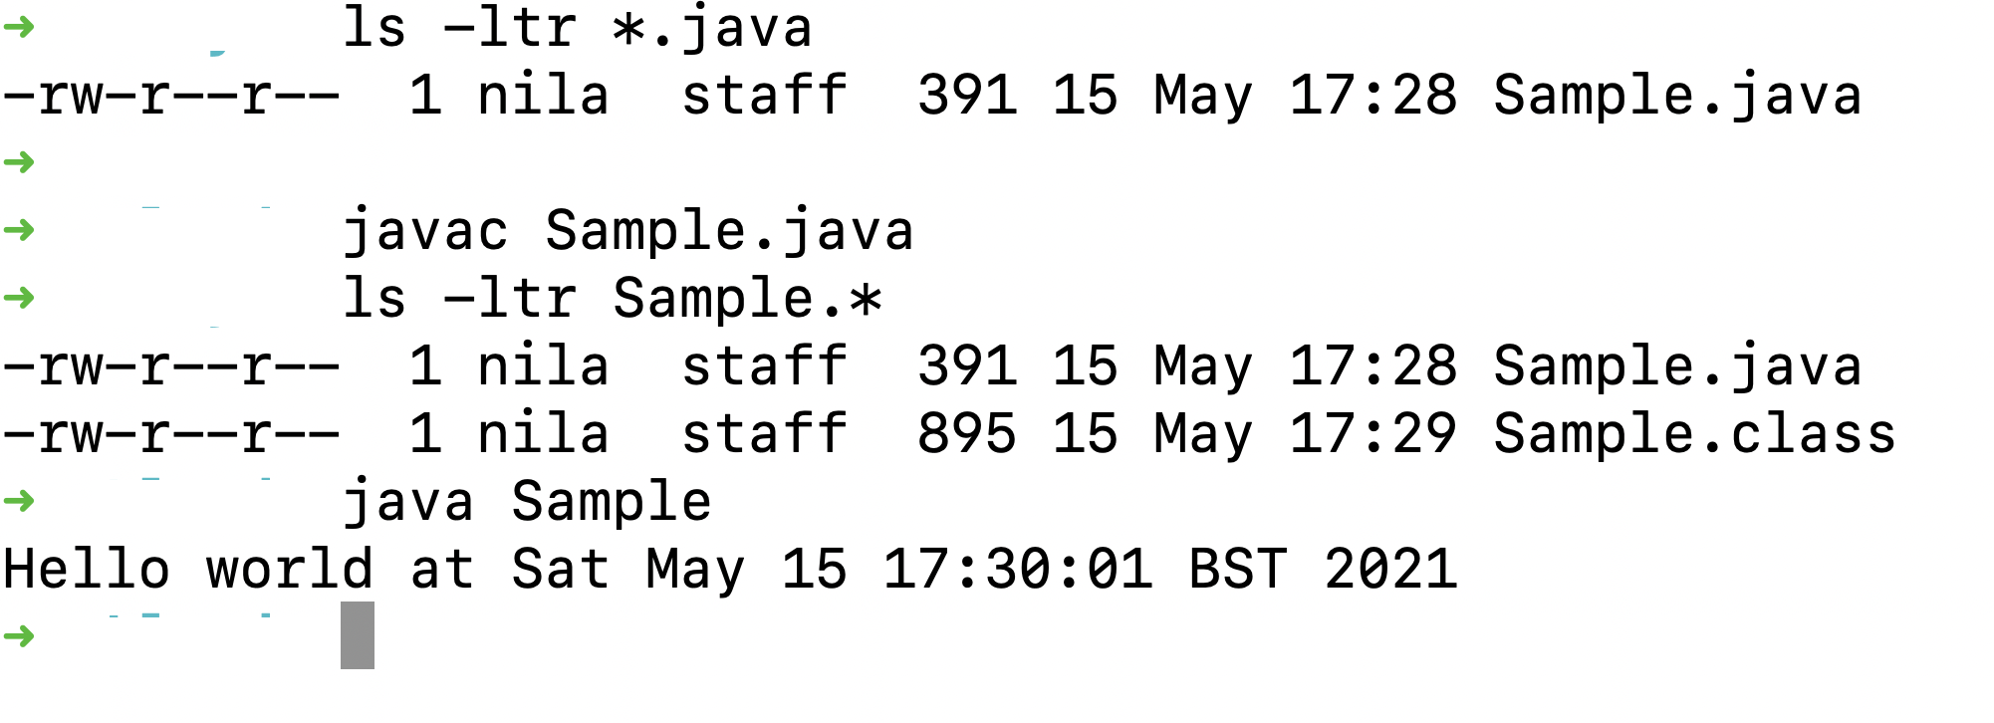
5. Creating, running and understanding a sample java program
Java Source file
// Package name goes here
import java.util.Date; // imports - other classes, static methods, variables
public class Sample { // Class name same as file name
// Entry point - main thread - statements executed sequentially
public static void main(String args[]){ //application arguments
System.out.println("Hello world at " + new Date()); // Your application code
}
}
File name – Sample.java
Class file
Class loader
Bytecode verified
Interpreter
Native Code
Run on hardware

Slide 10
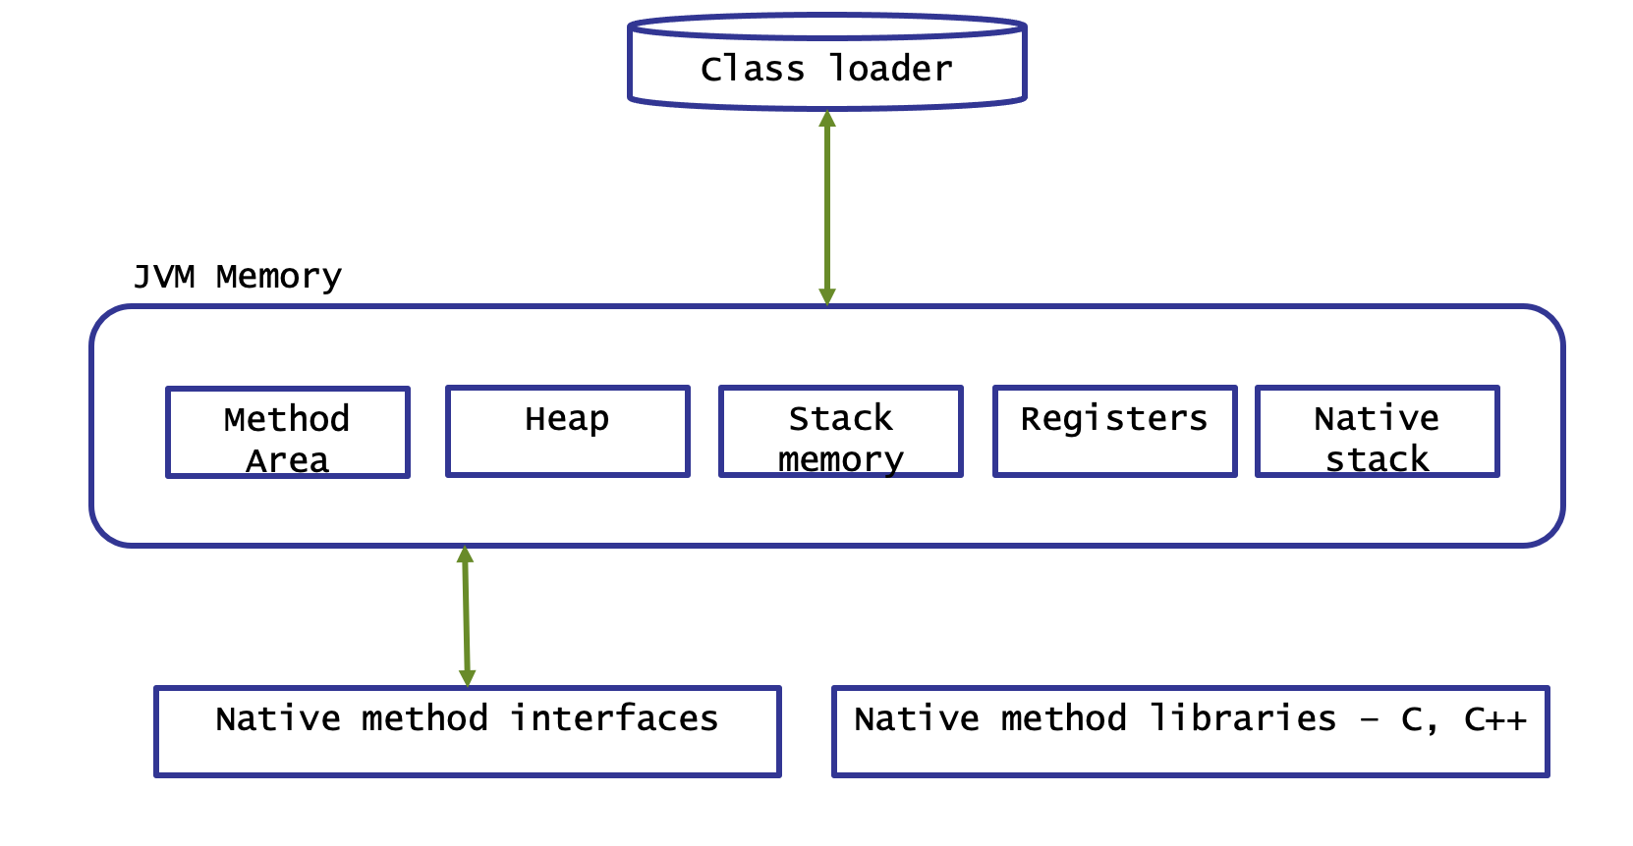
JVM again…

Slide 11
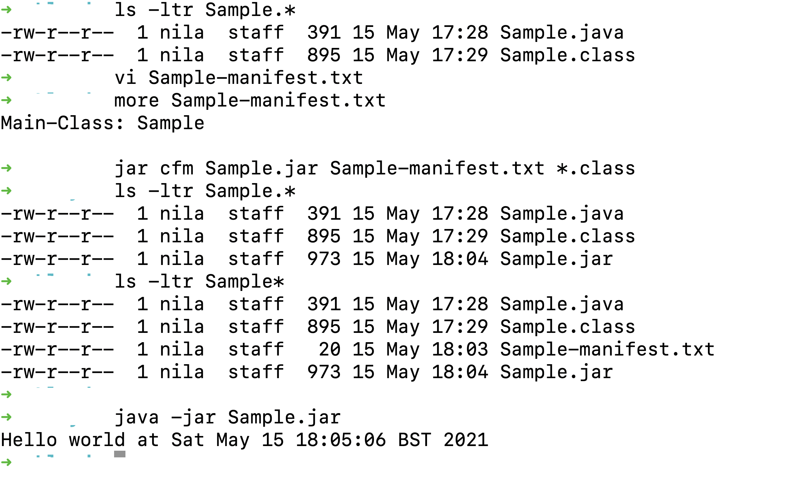
6. Packaging and deploying
Manifest file – Instructions for packaging
https://docs.oracle.com/javase/tutorial/deployment/jar/manifestindex.html
Packages
JAR – Java Archive
https://docs.oracle.com/javase/tutorial/deployment/jar/index.html
WAR – Web Archive
EAR – Enterprise Archive

Slide 12
7. OOPS concepts
Class - template, blueprint, prototype that defines the object. Has properties and behaviours defined
Object created with properties set and behaviours enabled
Encapsulation - Information hiding
mechanism of wrapping of data and attributes in one single unit and have control over fields/data (Class)
Use access modifiers (public, private, protected, default)
Abstraction - Implementation hiding
implemented using interfaces and abstract class

Slide 13
Continued…
Inheritance
mechanism by which one class is allow to inherit the features(fields and methods) of another class.
Super class, sub class, reusability
Polymorphism
Takes many form
Overloading – Signature changes
Overriding – implementation changes
Syntaxes, data types, frequently used objects
- We will introduce as we learn Spring Boot

Slide 14
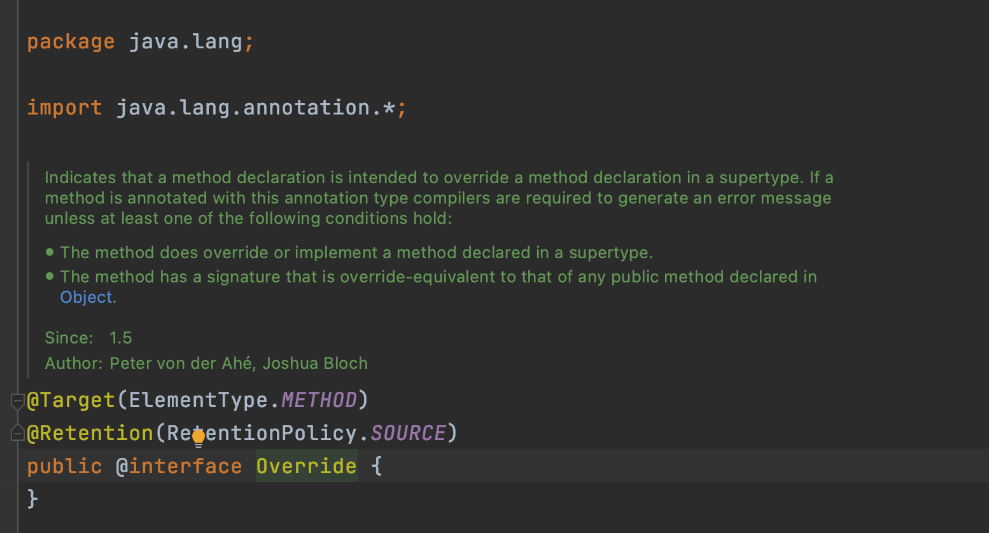
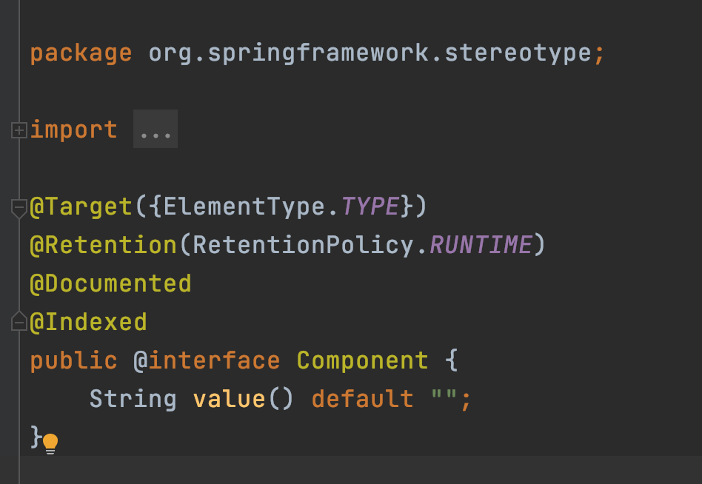
8. Annotations
Used to provide meta data for the class
Usually, annotations do not directly affect the execution of the code, but some types does
Compiler instructions
Build-time instructions (Uses processors and reflections)
Runtime instruction (Uses processors and reflections)

Slide 15
Next…
Learn as you get introduced to topics
What?
Why?
How?

Slide 16
Any Questions?

